Slide 1
影片敘述之自動生成 Video caption generation
吳克駿、江昶翰

Slide 2
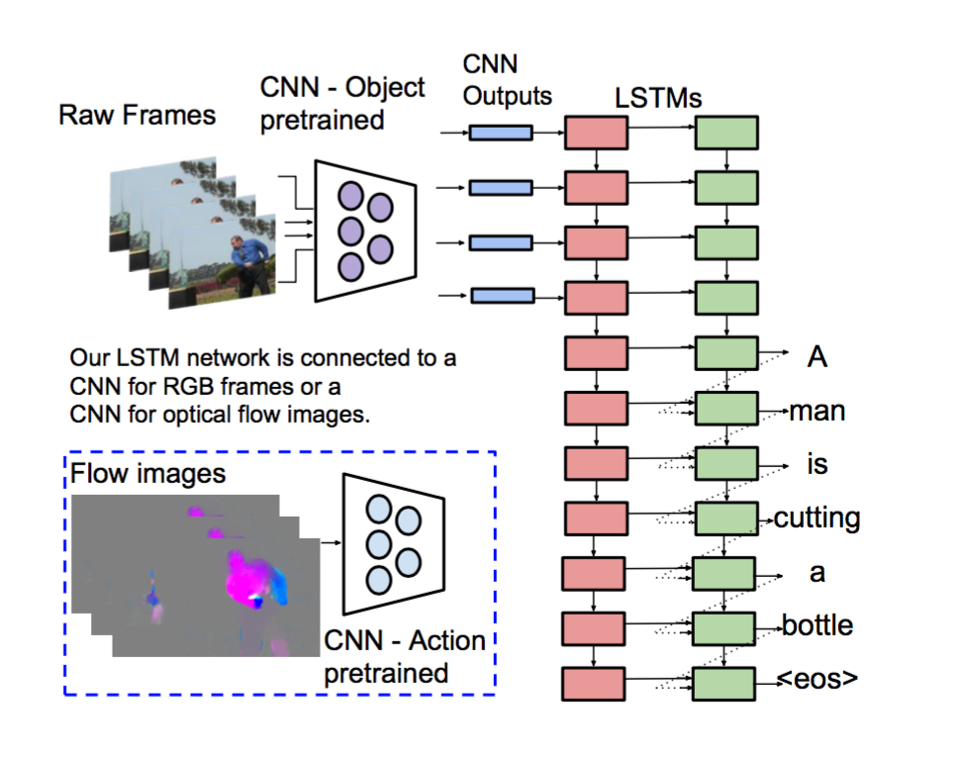
Two weeks ago….
S2VT with optical flow

Slide 3
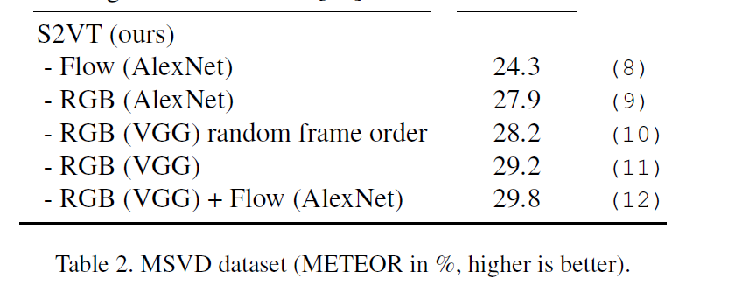
What TA wants us to do(think)?
Not using optical flow
Cost lots of resource
Maybe not improve so much(?
Try with a new method
But with audio data!

Slide 4
Paper review- Audio Set: An ontology and human-labeled dataset for audio events
Developed by Google
With carefully structured hierarchical ontology of 632 audio classes
With 1,789,621(now 2,084,320) segment dataset
10 second sements of YouTube videos
Released in March, 2017

Slide 5
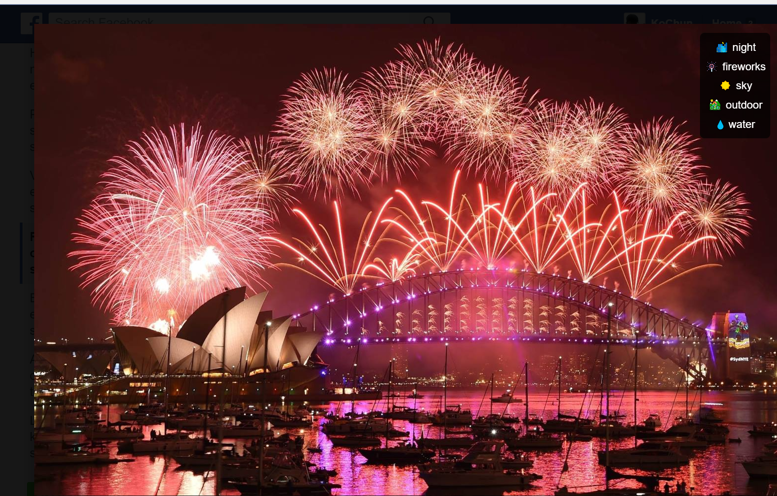
Motive
Image labels in ImageNet dataset
Provide 1 million images labeled with 1000 object categories.
EX: Facebook Image

Slide 6
ImageNet-like Audio Set
Structured into an abstraction hierarchy called Audio Set Ontology
如何分類？
全面性
易讀性，可立即反應
可被大眾辨別
僅可由聲音辨別，不可結合影像(搥擊聲vs赤腳在木地板走路)

Slide 7
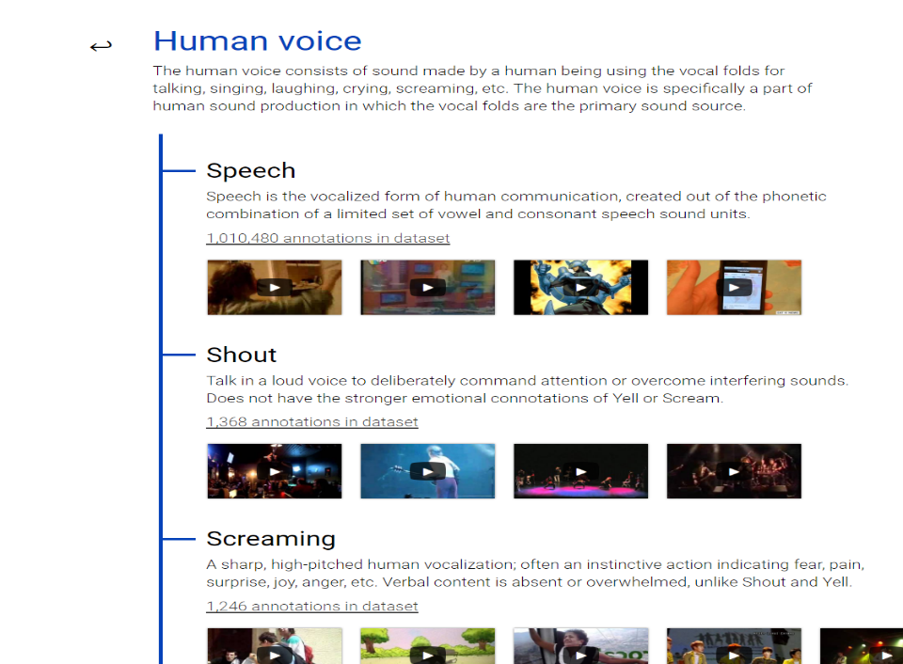
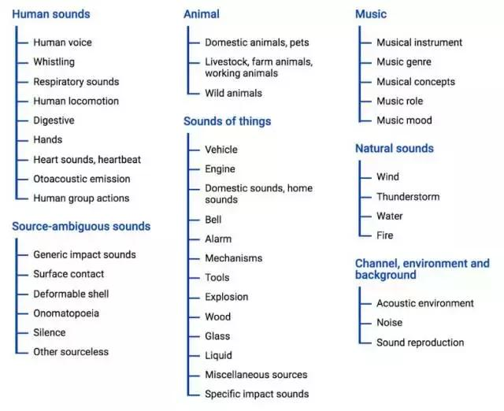
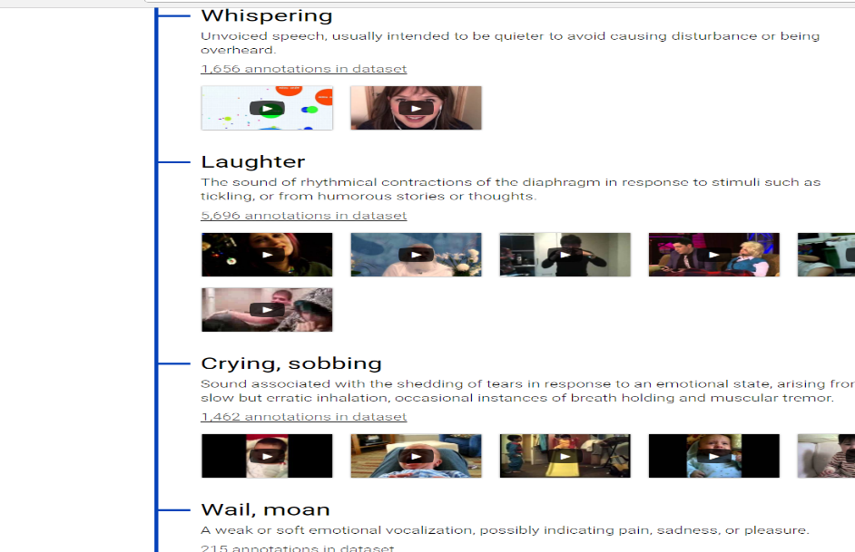
The top two layers of the Audio Set Ontology

Slide 8
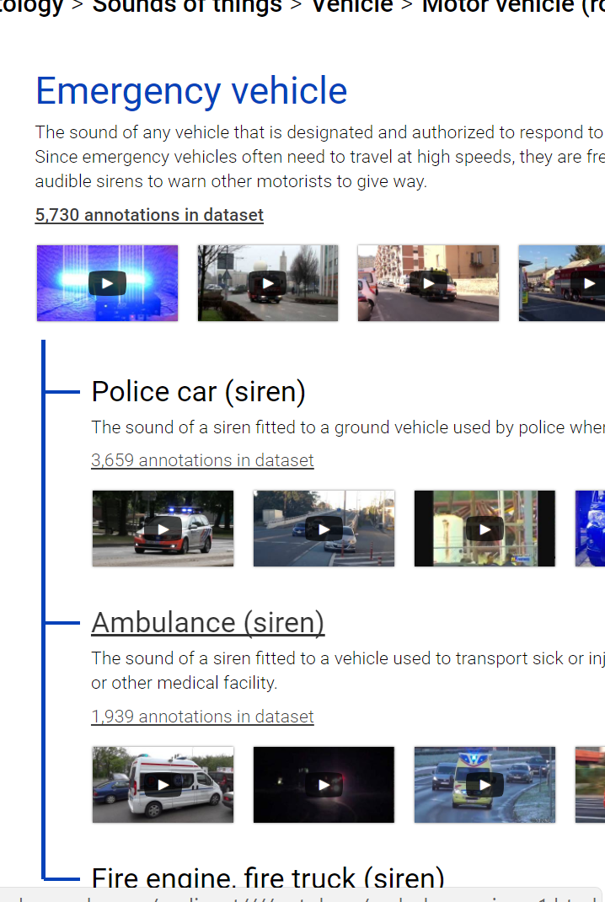
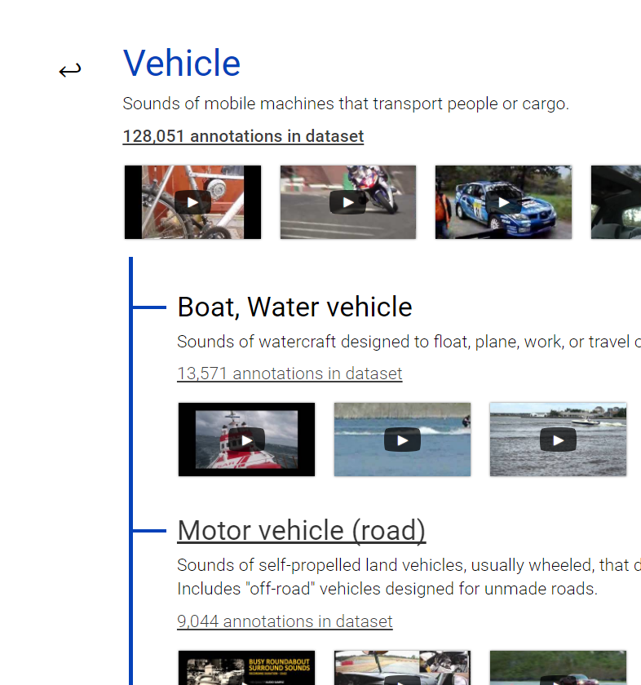
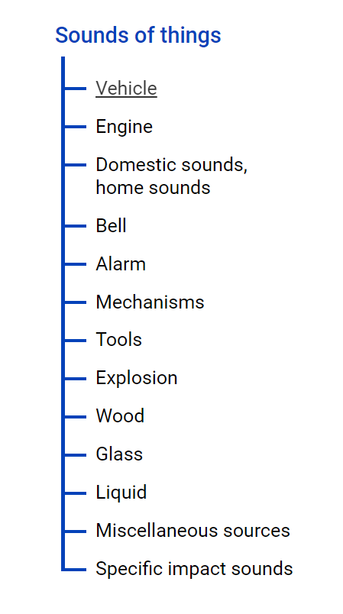
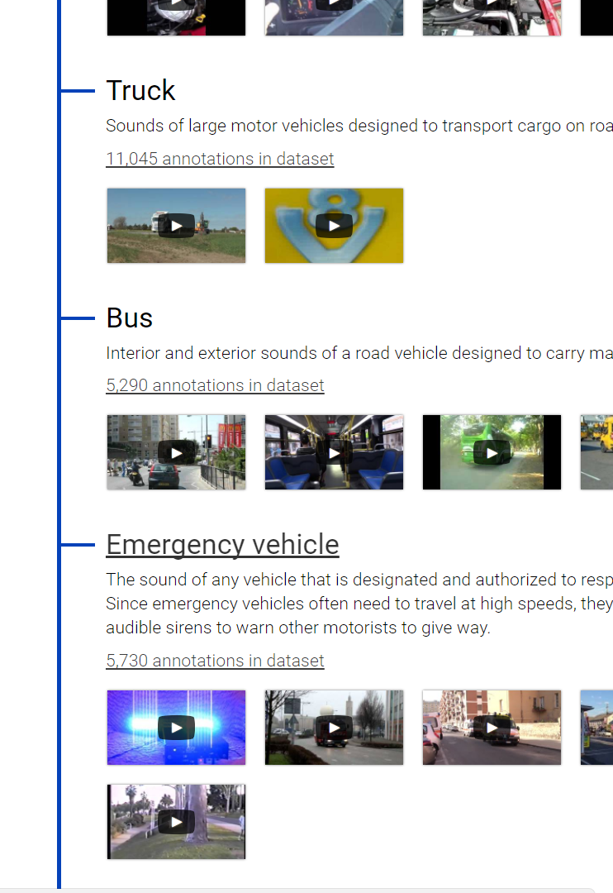
Maximum depth: 6 levels(now maybe 5)

Slide 9
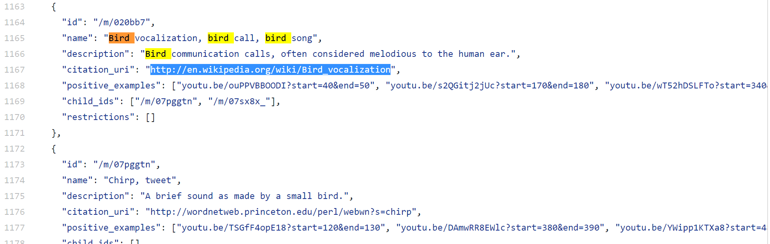
Ontology.json
Citation: http://en.wikipedia.org/wiki/Bird_vocalization
Examples: http://youtu.be/ouPPVBBOODI?start=40&end=50
Restrictions:
56 are ”blacklisted” (like Alto Saxophone, Sound of Things)
22 are “abstract” (like Human sounds)

Slide 10
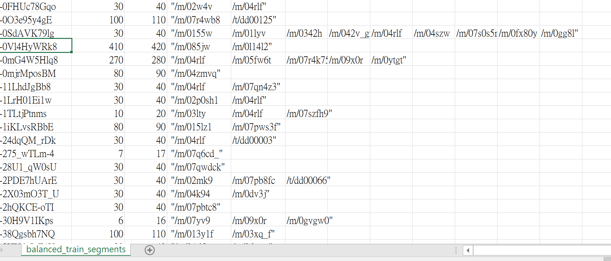
Audio Set Dataset(in CSV file)
By Human rating, unanimous in 76.2% of votes, 23.6% 2:1 majority, 0.5% unsure

Slide 11
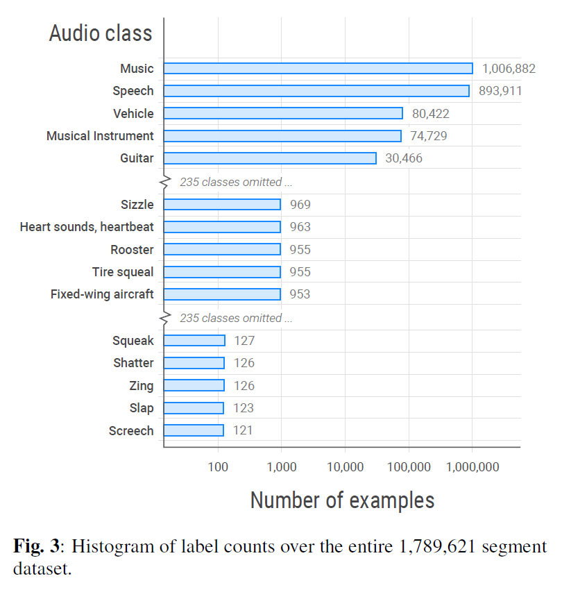
Number of examples

Slide 12
Reference
Google Audio set: https://research.google.com/audioset////index.html
Audio Set Ontology: https://github.com/audioset/ontology
Paper reference: https://research.google.com/pubs/pub45857.html

Slide 13
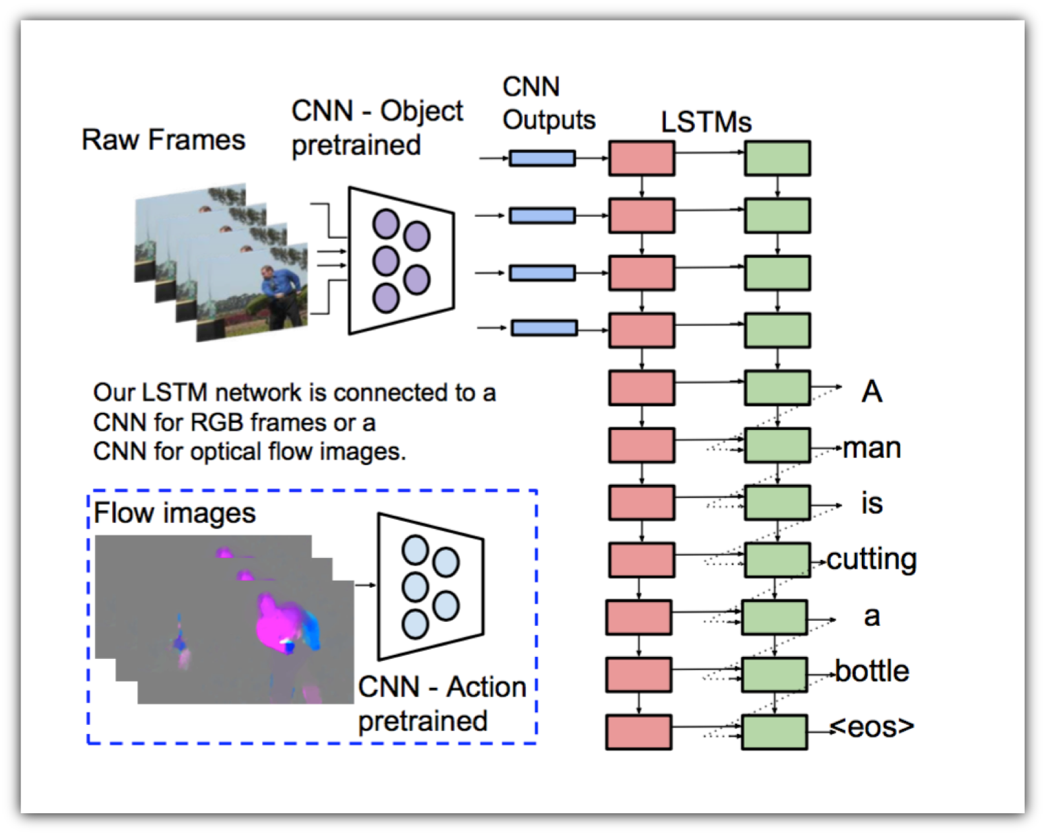
CNN practice

Slide 14
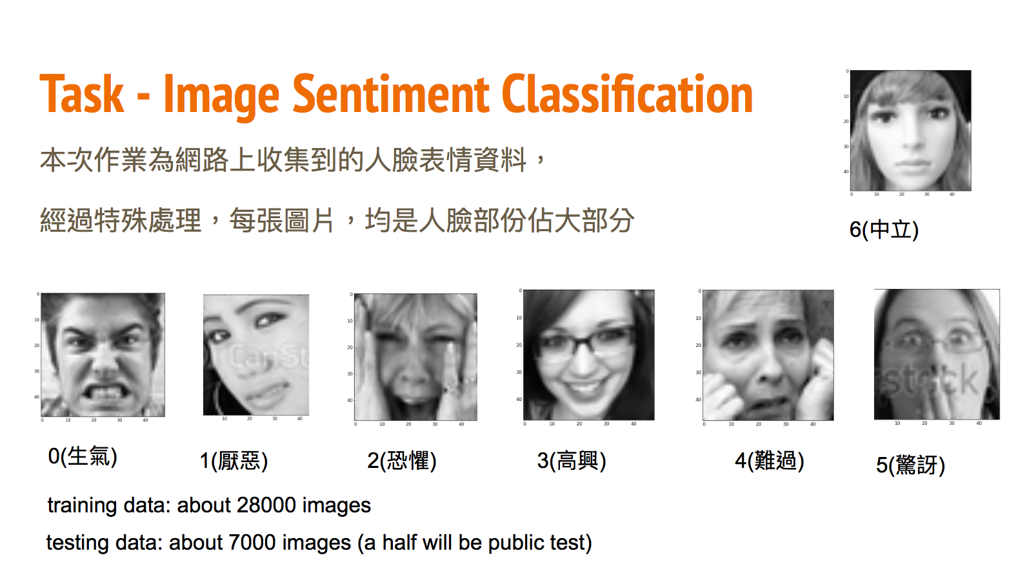
CNN practice

Slide 15
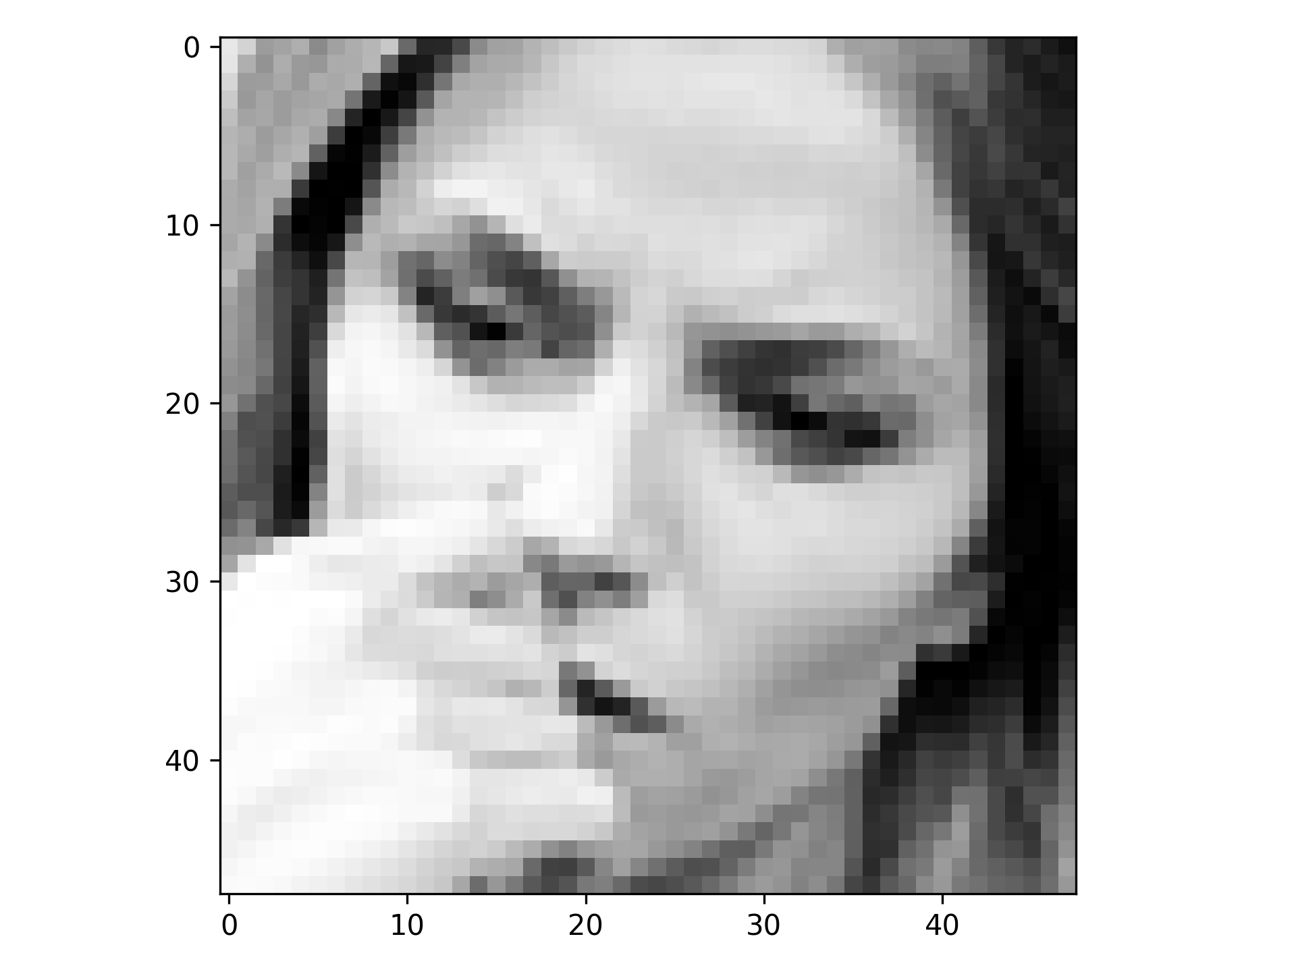
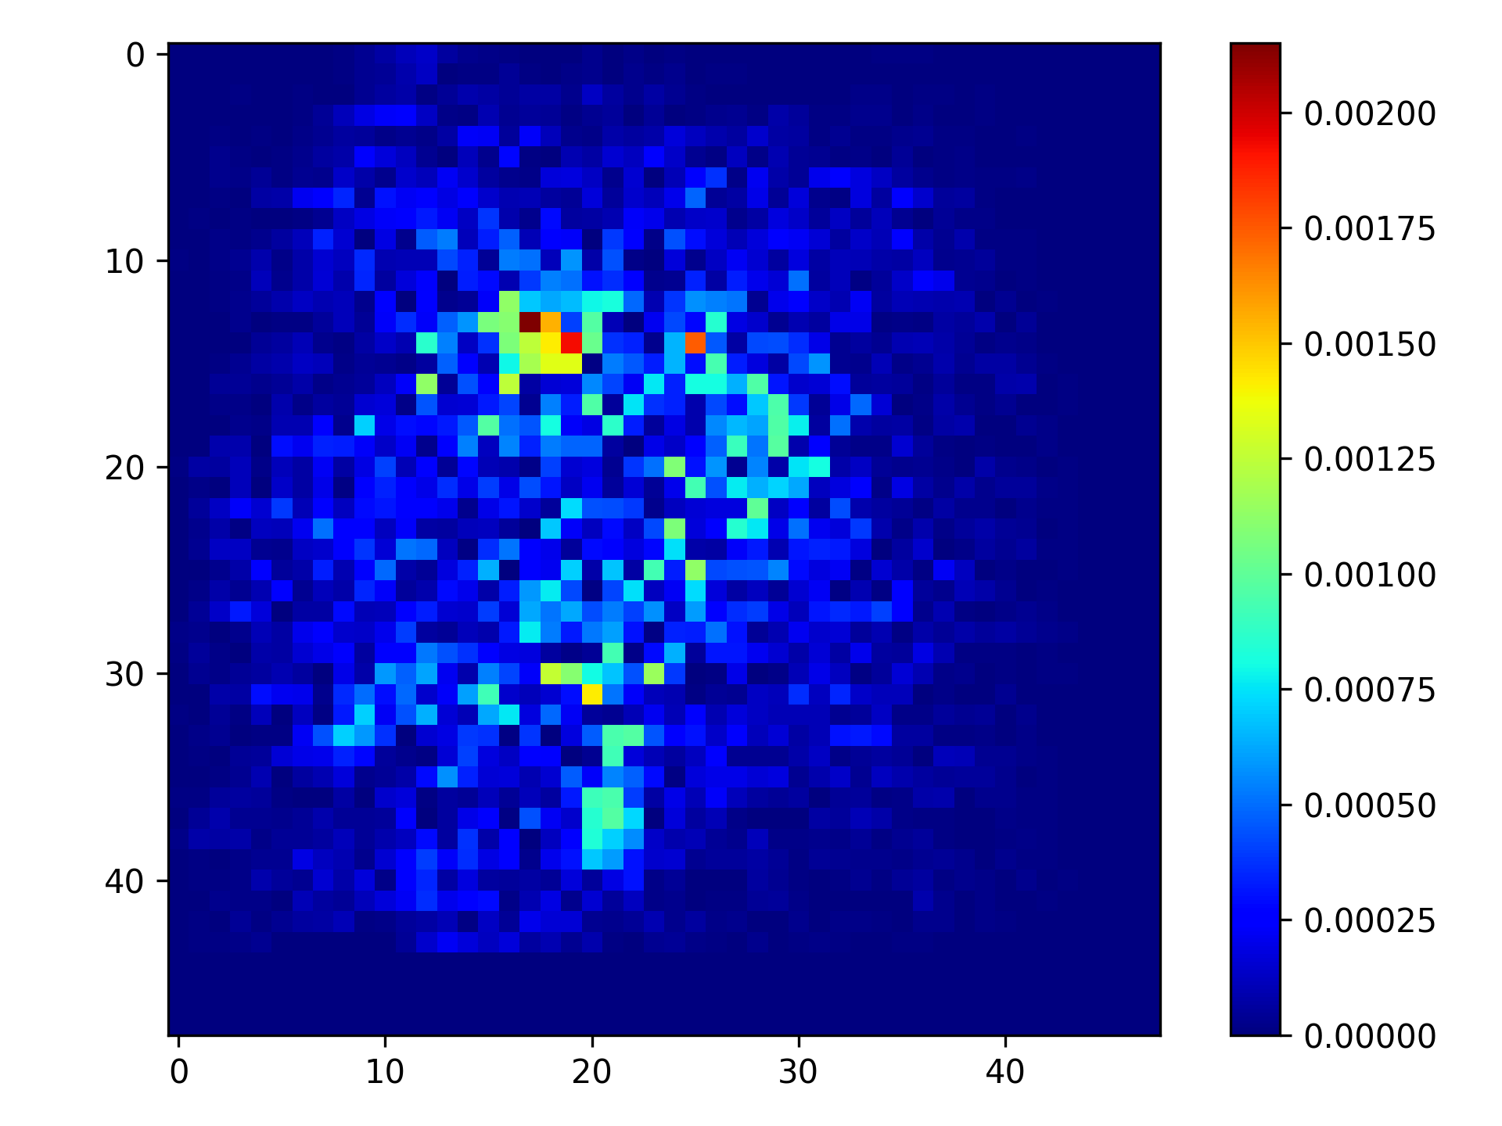
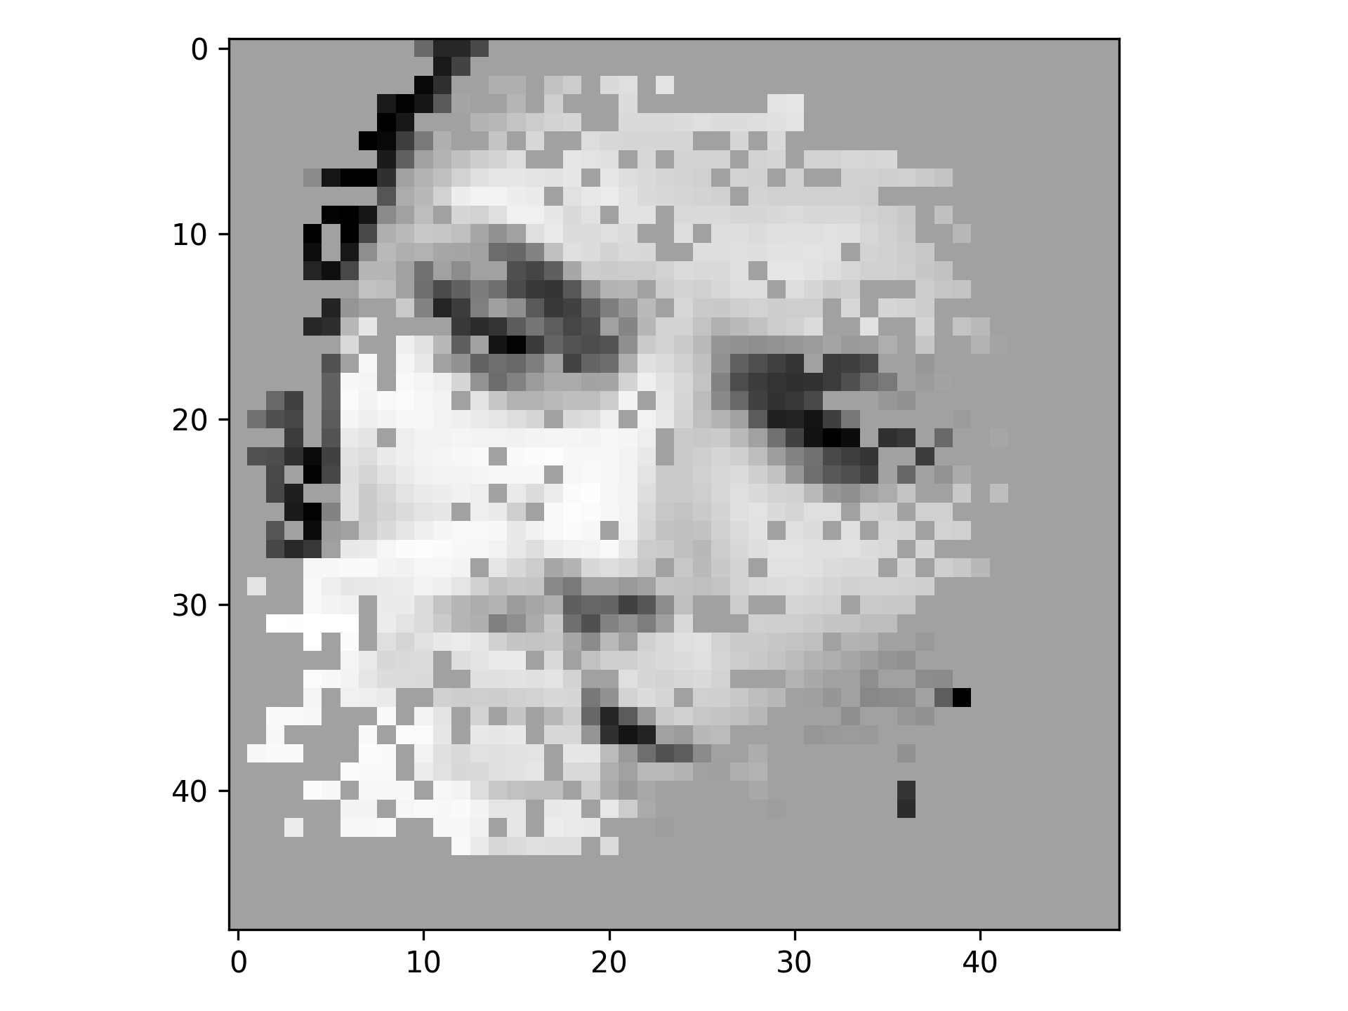
CNN practice ：saliency Map

Slide 16
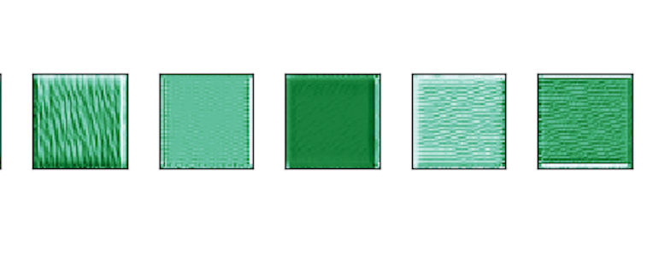
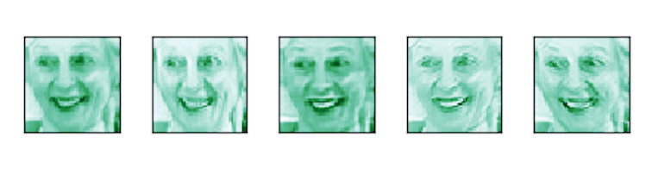
CNN Practice : Visualize filter
Gradient ascent Filter visualize

Slide 17
Next step: LSTM & S2S
Without audio?
With audio?
GPU

